Slide 1
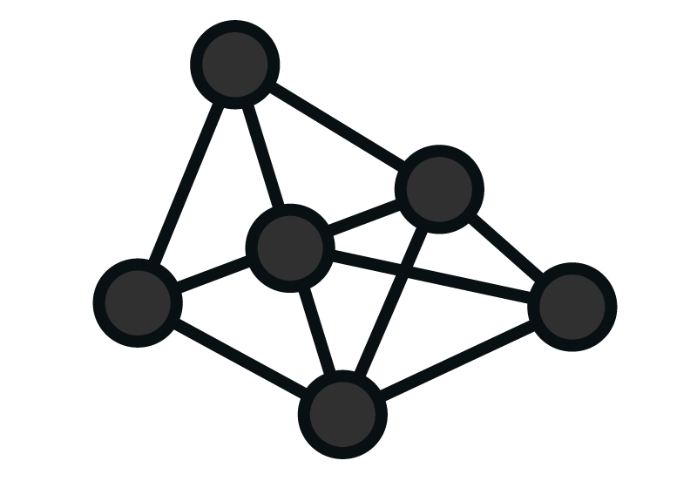

IRIS4 DSH task processing & VDC productivity prediction
Sponsor: Elathen Zheng
Dev Leader: Yellow Huang, Dante Jiang

Slide 2




Background
Store task status & user behavior
Pick task & do
IRIS4 Dashboard
IRIS4 DB
VDC Users

Slide 3







Plan
Store task status & user behavior
Pick task & do
IRIS4 Dashboard
IRIS4 DB
Effort prediction
Fetch data & train
VDC Users
Personal productivity
View
Auto task schedule
Visualization

Slide 4
Plan
100w+ Activities / month
600w+ Activity histories / month
Learn how to perform machine learning
Build model(s)
Data visualization

Slide 5
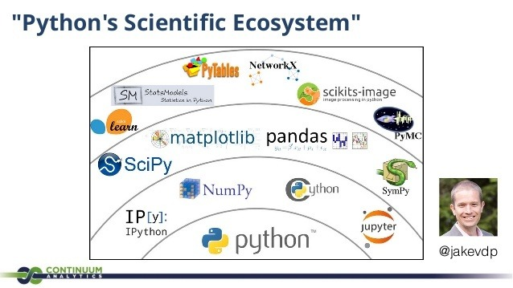
ML tools

Slide 6
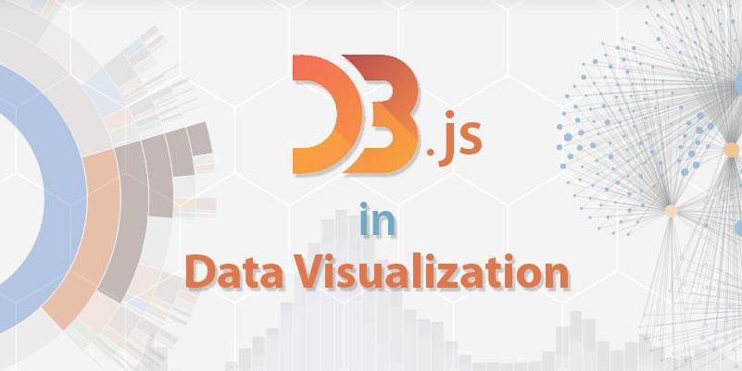
Data visualization

Slide 7
